Slide 1


MDSC 508
EVALUATING QUALITY CONTROL FILTERS AND IMPUTATION REFERENCE PANELS IN PHARMACOGENOMIC VARIANT CALLING
Courtney Lenz
Project Supervisors:
Chad Bousman
Ankita Narang

Slide 2

What is Pharmacogenomics?
Pharmacogenomics (or PGx) is a field of research that explores how genes influence drug response
Pharmacogenes encode proteins that affect how drugs are processed in the body
Variants that alter the function of these genes are known as star-alleles
Image Source: National Human Genome Research Institute. Pharmacogenomics [Internet]. [cited 2024 Feb 5]. Available from: https://www.genome.gov/dna-day/15-ways/pharmacogenomics
Notes:
Pharmacogenomics (or PGx) is a field of research that explores how genes influence drug response
Pharmacogenes encode proteins that affect how drugs are processed in the body, which include metabolizing enzymes and transporters
The variants (or groups of variants) that alter these functions are known as star alleles

Slide 3
What is Pharmacogenomics?
The Association for Molecular Pathology (AMP) has identified several critical star (*)-alleles for PGx testing
Tier 1 alleles are the minimum set
Tier 2 alleles are optional
Notes:
The Association for Molecular Pathology has classified several critical star alleles for PGx testing
Tier 1 is considered the minimum set required for testing
While tier 2 is optional for an extended genotyping panel

Slide 4
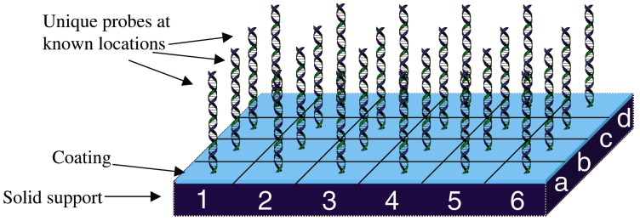
Genomic Data Analysis
Array-based sequencing is the most popular sequencing method for GWAS
SNP arrays detect genetic variations by using DNA probes that bind to specific sequences
Image Source: Conzone SD, Pantano CG. Glass slides to DNA microarrays. Materials Today. 2004 Mar 1;7(3):20–6.
Notes:
PGx variants are typically investigated using genome-wide association studies
Array-based sequencing is the most popular sequencing method for GWAS, which targets specific regions of the genome using DNA probes.
This method will result in "gaps" in the genome that haven’t been directly sequenced

Slide 5
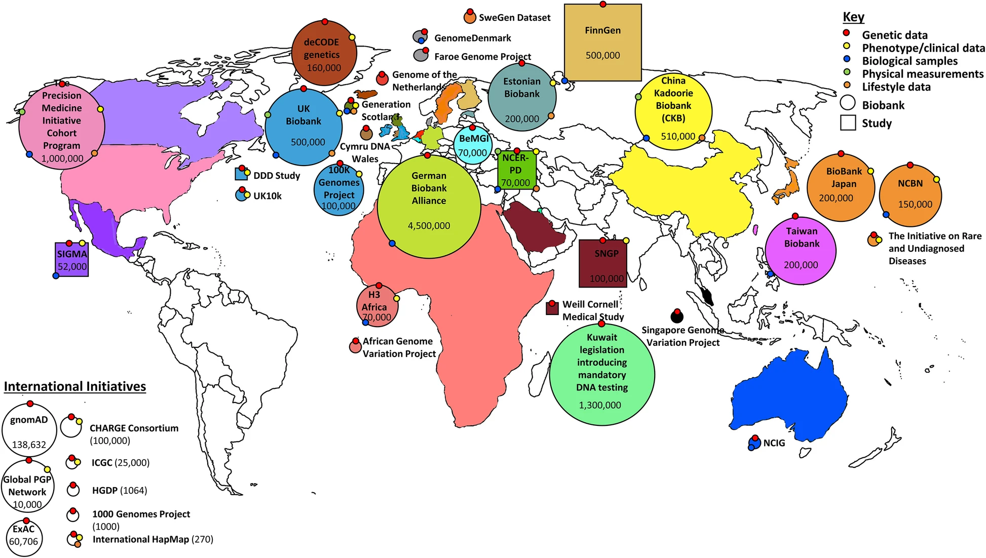
Genomic Data Analysis
Image Source: Carress H, Lawson DJ, Elhaik E. Population genetic considerations for using biobanks as international resources in the pandemic era and beyond. BMC Genomics. 2021 May 17;22(1).
Notes:
The number and size of biobanks worldwide are rapidly expanding and a lot of the data available on these biobanks has been sequenced using microarrays
Therefore, it’s important to optimize data preprocessing methods for use in secondary GWAS analyses for PGx applications

Slide 6
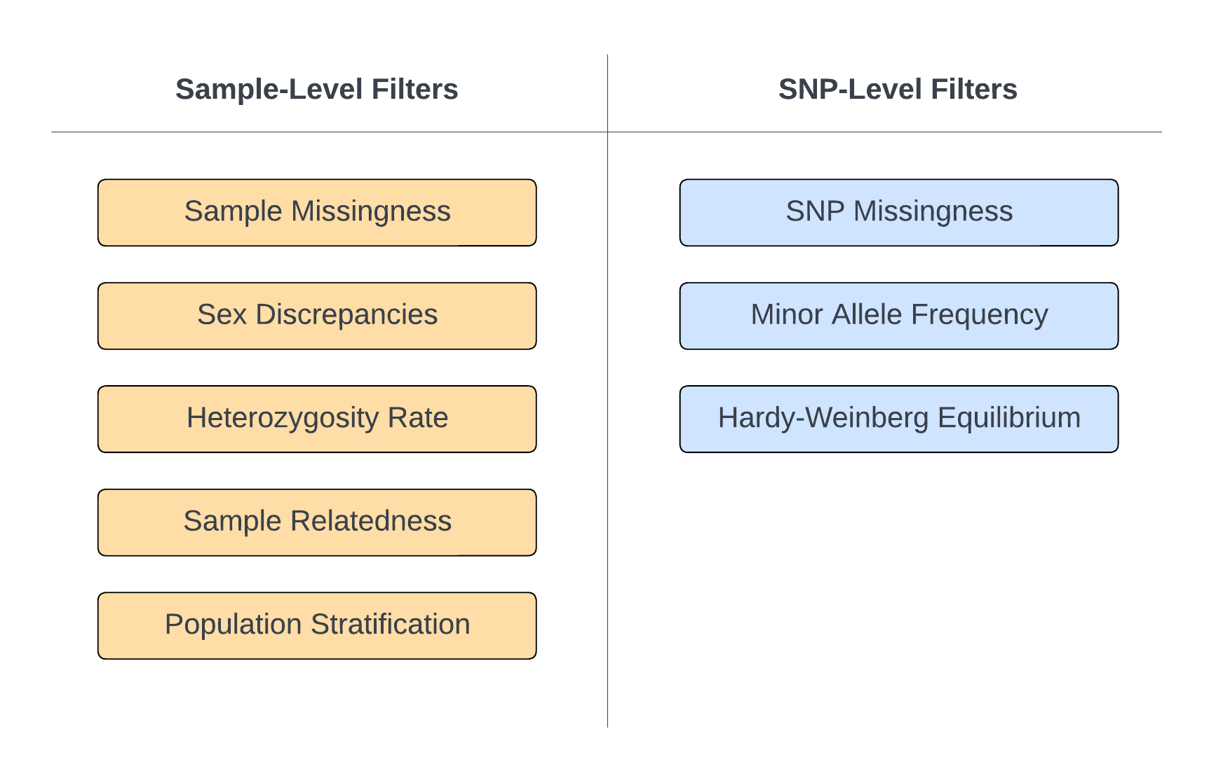
Data Preprocessing
QC Filtering
PGx variants often exhibit low allele frequencies within populations
blah
QC filters that are too strict could result in the loss of valuable data and introduce false negatives
Notes:
The first step in data preprocessing is typically quality control (or QC)
PGx variants often exhibit low allele frequencies within populations
Therefore, QC filters that are too strict could result in the loss of valuable data and introduce false negatives

Slide 7
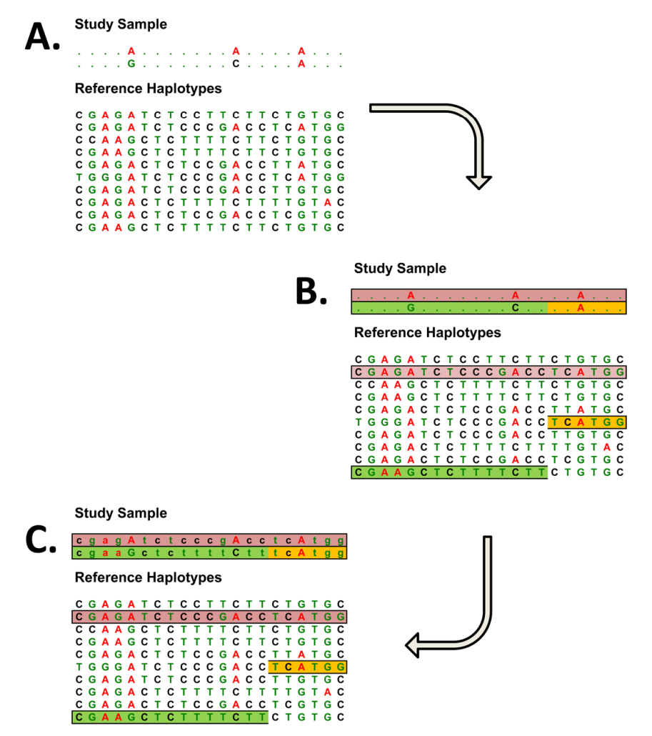
Data Preprocessing
Imputation
blah
Genotype imputation is a statistical method that utilizes patterns of inheritance to predict unobserved genotypes
The reference panel and the imputation algorithm both contribute to imputation accuracy
Image Source: Li Y, Willer C, Sanna S, Abecasis G. Genotype Imputation. Annu Rev Genomics Hum Genet. 2009;10:387–406.
Notes:
Another important step in data preprocessing is genotype imputation, which is a statistical method that utilizes patterns of inheritance to predict unobserved genotypes
Previously I mentioned that array-based sequencing leaves gaps in the genome, like this example here
Essentially, imputation algorithms compare a sample’s known alleles against a panel of reference haplotypes, search for patterns, and then fill in the missing data with the most likely sequences
Both the reference panel and the imputation algorithm contribute to imputation accuracy, however, most research into imputation accuracy has focused on the algorithm alone

Slide 8
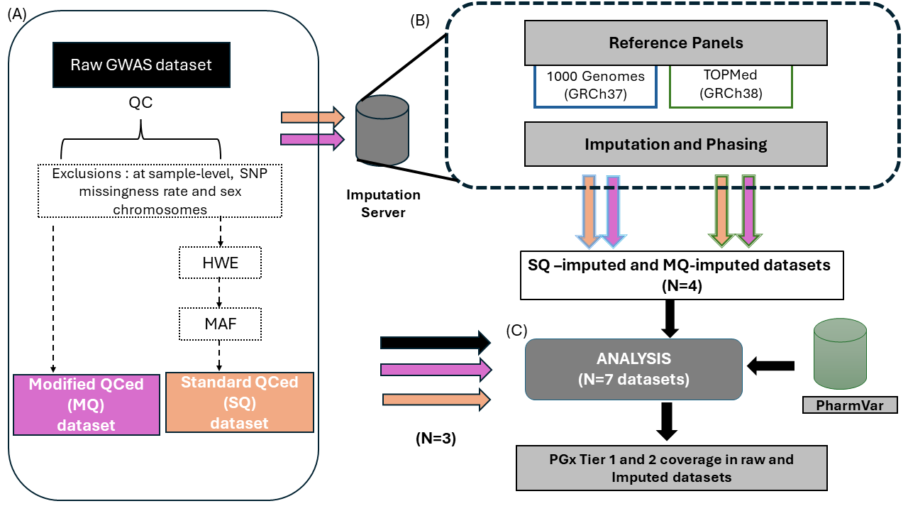
Methodology Overview
Notes:
To assess the impact of QC filters and imputation panels of PGx variant calling, I will:
1. Apply standard and modified QC filtering to GWAS data
2. Impute filtered datasets using commonly used reference panels
3. Cross-reference PGx variants in each dataset with PharmVar and assess star allele coverage

Slide 9

Dataset
GWAS Data
Unfiltered genome-wide association data provided by the CLOZapine INternational (CLOZIN) consortium.
Participants were genotyped using Illumina’s Infinium Global Screening Array (GSA) V3.0
Image Source: Okhuijsen-Pfeifer C, van der Horst MZ, Bousman CA, Lin B, van Eijk KR, Ripke S, et al. Genome-wide association analyses of symptom severity among clozapine-treated patients with schizophrenia spectrum disorders. Transl Psychiatry. 2022 Apr 7;12:145.
Notes:
For my dataset unfiltered genome-wide association data provided by the clozapine international consortium
Participants were genotyped using Illuminas Infinium Global Screening Array

Slide 10
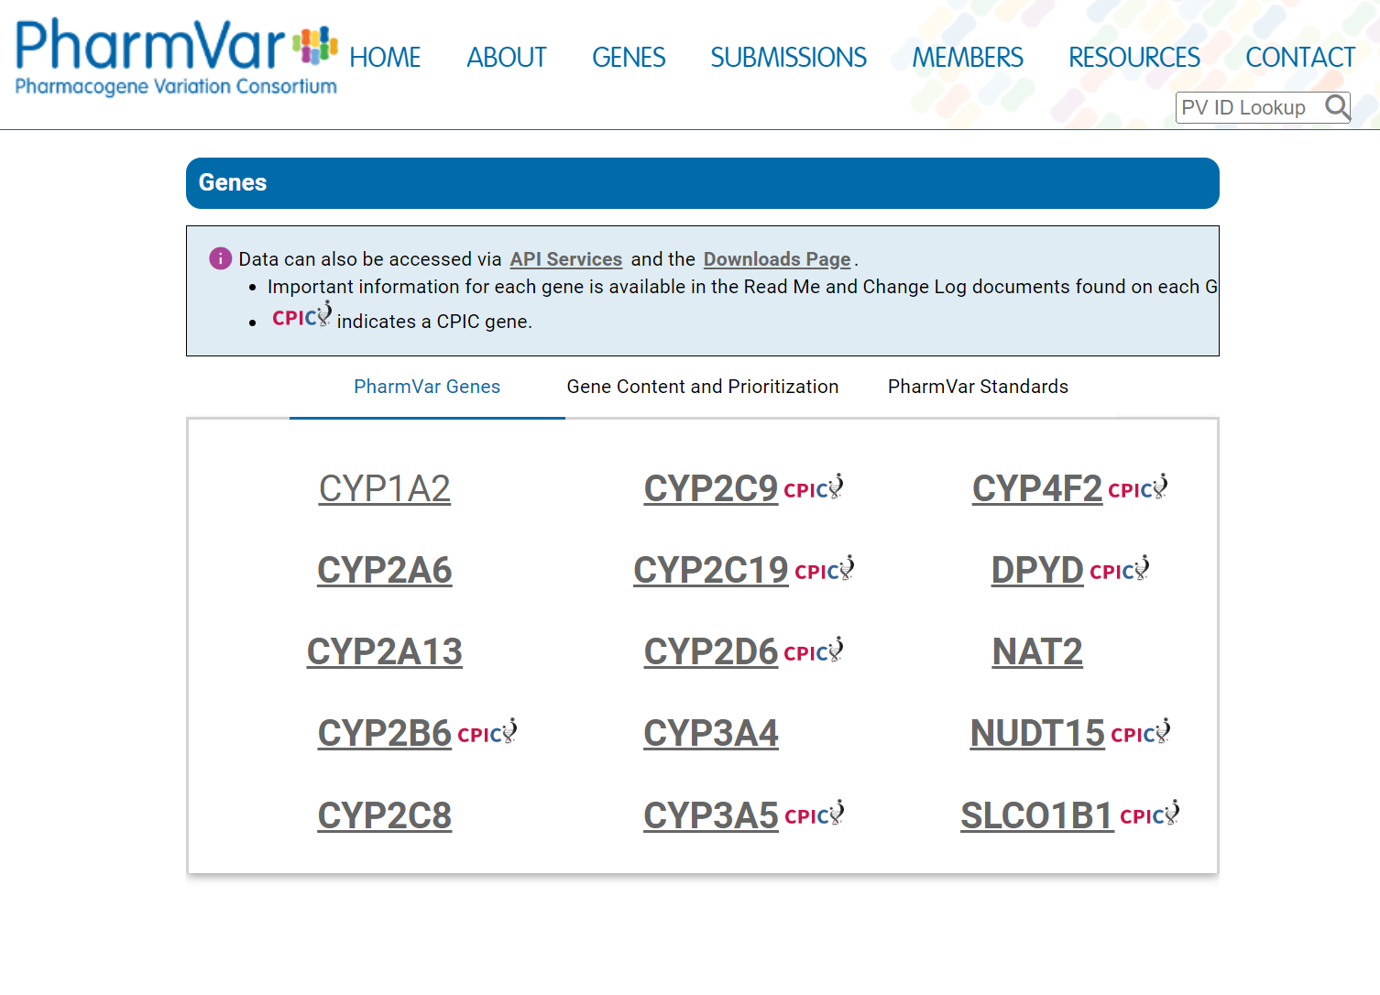









Dataset
Star Allele Definitions
Variant information for 9 pharmacogenes was collected from PharmVar
Image Source: PharmVar [Internet]. Pharmacogene Variation Consortium; [cited 2024 Mar 12]. Available from: https://www.pharmvar.org/
Notes:
Star allele variant information for these 9 pharmacogenes was collected from PharmVar

Slide 11
QC Filtering
Standard
Modified
Remove individuals who failed sample-level QC
Remove SNPs with > 10% missingness
Remove SNPs with MAF < 1%
Remove SNPs with HWE > 1x10e-4
Remove individuals who failed sample-level QC
Remove SNPs with > 10% missingness
Notes:
For QC filtering, both methods included the removal of individuals who failed sample-level QC, as well as the removal of SNPs with > 10% missingness
The standard method also included the removal of SNPs with a minor allele frequency (or MAF) of < 1% and a Hardy Weinberg equilibrium (or HWE) deviation of > 1x10-4

Slide 12
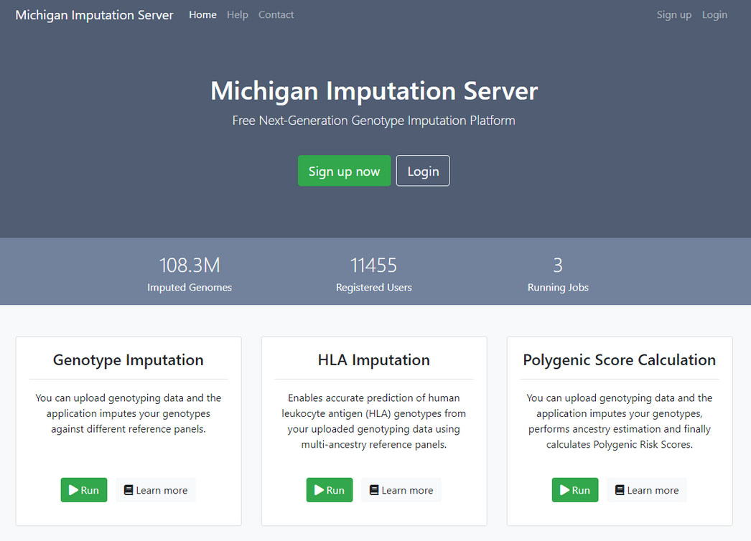
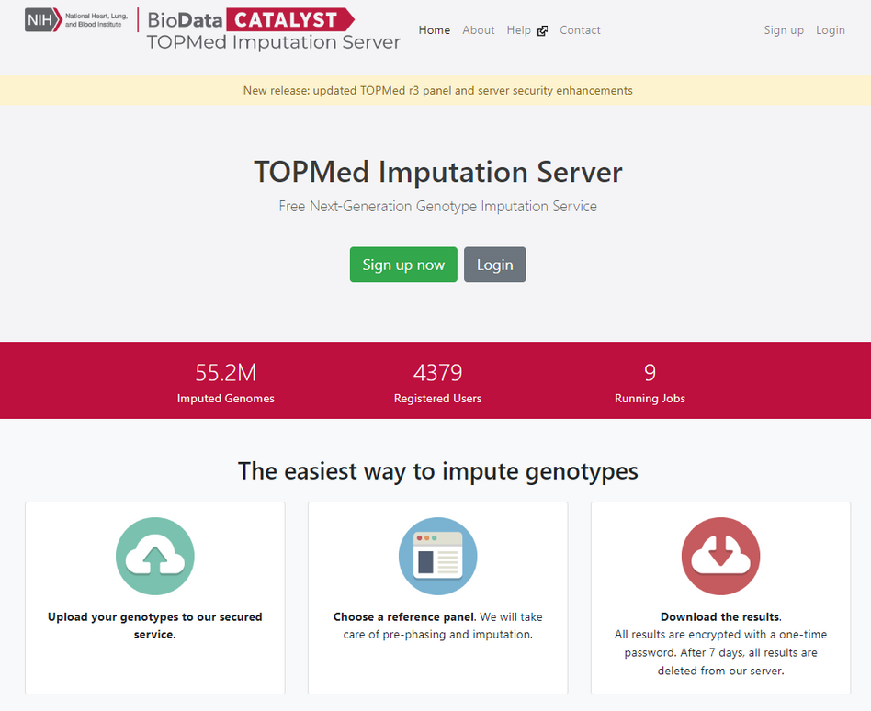
Imputation
Image Source: Michigan Imputation Server [Internet]. University of Michigan; [cited 2024 Mar 22]. Available from: https://imputationserver.sph.umich.edu/index.html#!
Image Source: TOPMed Imputation Server [Internet]. National Heart, Lung, and Blood Institute (U.S.); [cited 2024 Mar 22]. Available from: https://imputation.biodatacatalyst.nhlbi.nih.gov/#!
Notes:
For imputation, these were the 2 servers used:
The michegan server was used to impute with the 1000 genomes reference panel
The topmed server was used to impute with the topmed reference panel

Slide 13
Analysis
Identifying PGx Variants
Map variants from each dataset to PharmVar variants
Label identified variants with the corresponding star allele(s)
Notes:
The first step for the analysis was to identify the PGx variants
This was done by mapping the variants in each dataset to the PharmVar variants by their position.
All identified PGx variants were then labelled with their corresponding star alleles

Slide 14
Analysis
Identifying PGx Variants
Determining Coverage
Map variants from each dataset to PharmVar variants
Label identified variants with the corresponding star allele(s)
Compare PGx variants in each dataset to star allele definitions from PharmVar
Record how many variants for each star allele are present or missing
Write full, partial, or no coverage
Notes:
Next, star allele coverage was determined by comparing the identified PGx variants to the star allele definitions from PharmVar.
All variants present or missing for a given star allele were recorded and coverage was written based on how many variants were missing

Slide 15
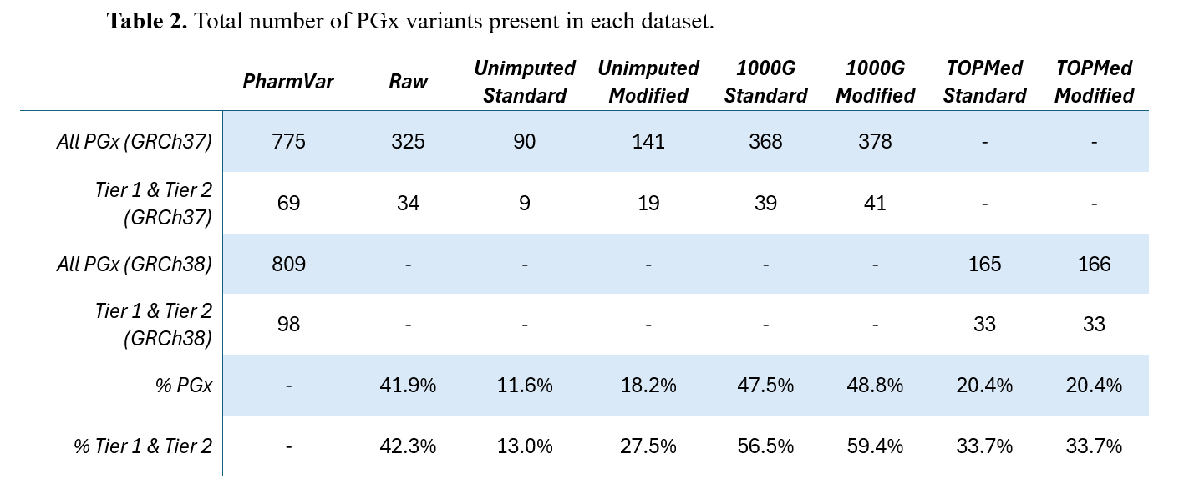
Results
Preliminary Results
Notes:
Moving into results,
Initially, 325 (or ~42%) of the Pharmvar variants were identified in the raw dataset, which dropped to ~12% after standard filtering and ~18% after modified filtering
For tier 1 and tier 2 specifically, over twice as many variants were retained through modified filtering than in standard filtering

Slide 16
Results
Preliminary Results
Notes:
However, when comparing the imputed results, there was virtually no difference between the standard and modified filtering methods

Slide 17
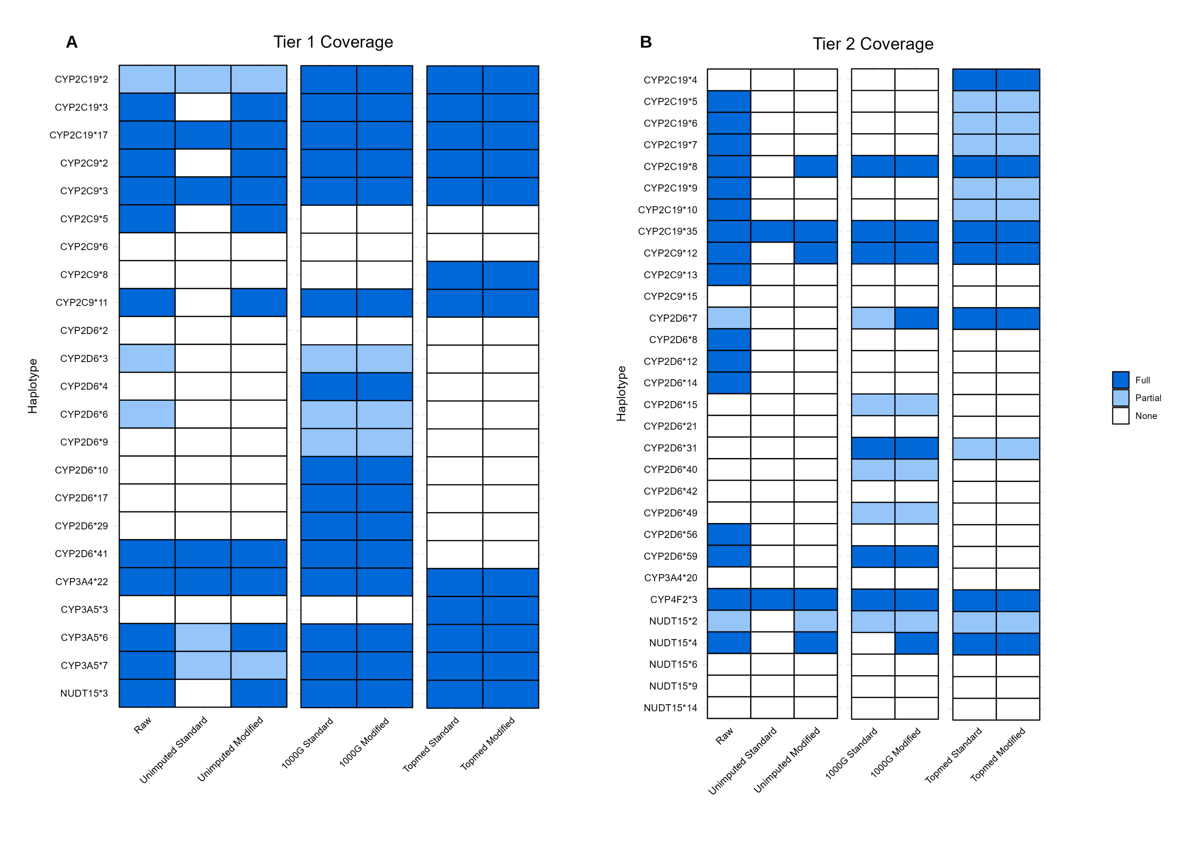
Average Full Coverage:
~65%
~52%
~26%
~23%
Notes:
Between imputation panels, 1000G outperformed topmed in both tiers, with full coverage of ~65% for tier 1 and ~26% for tier 2

Slide 18
Notes:
The 2 imputation methods primarily differ in their coverage of CYP2D6 and CYP2C19, with 1000G providing superior coverage of CYP2D6 in both tiers while topmed offers slightly better coverage of CYP2C19 in tier 2

Slide 19
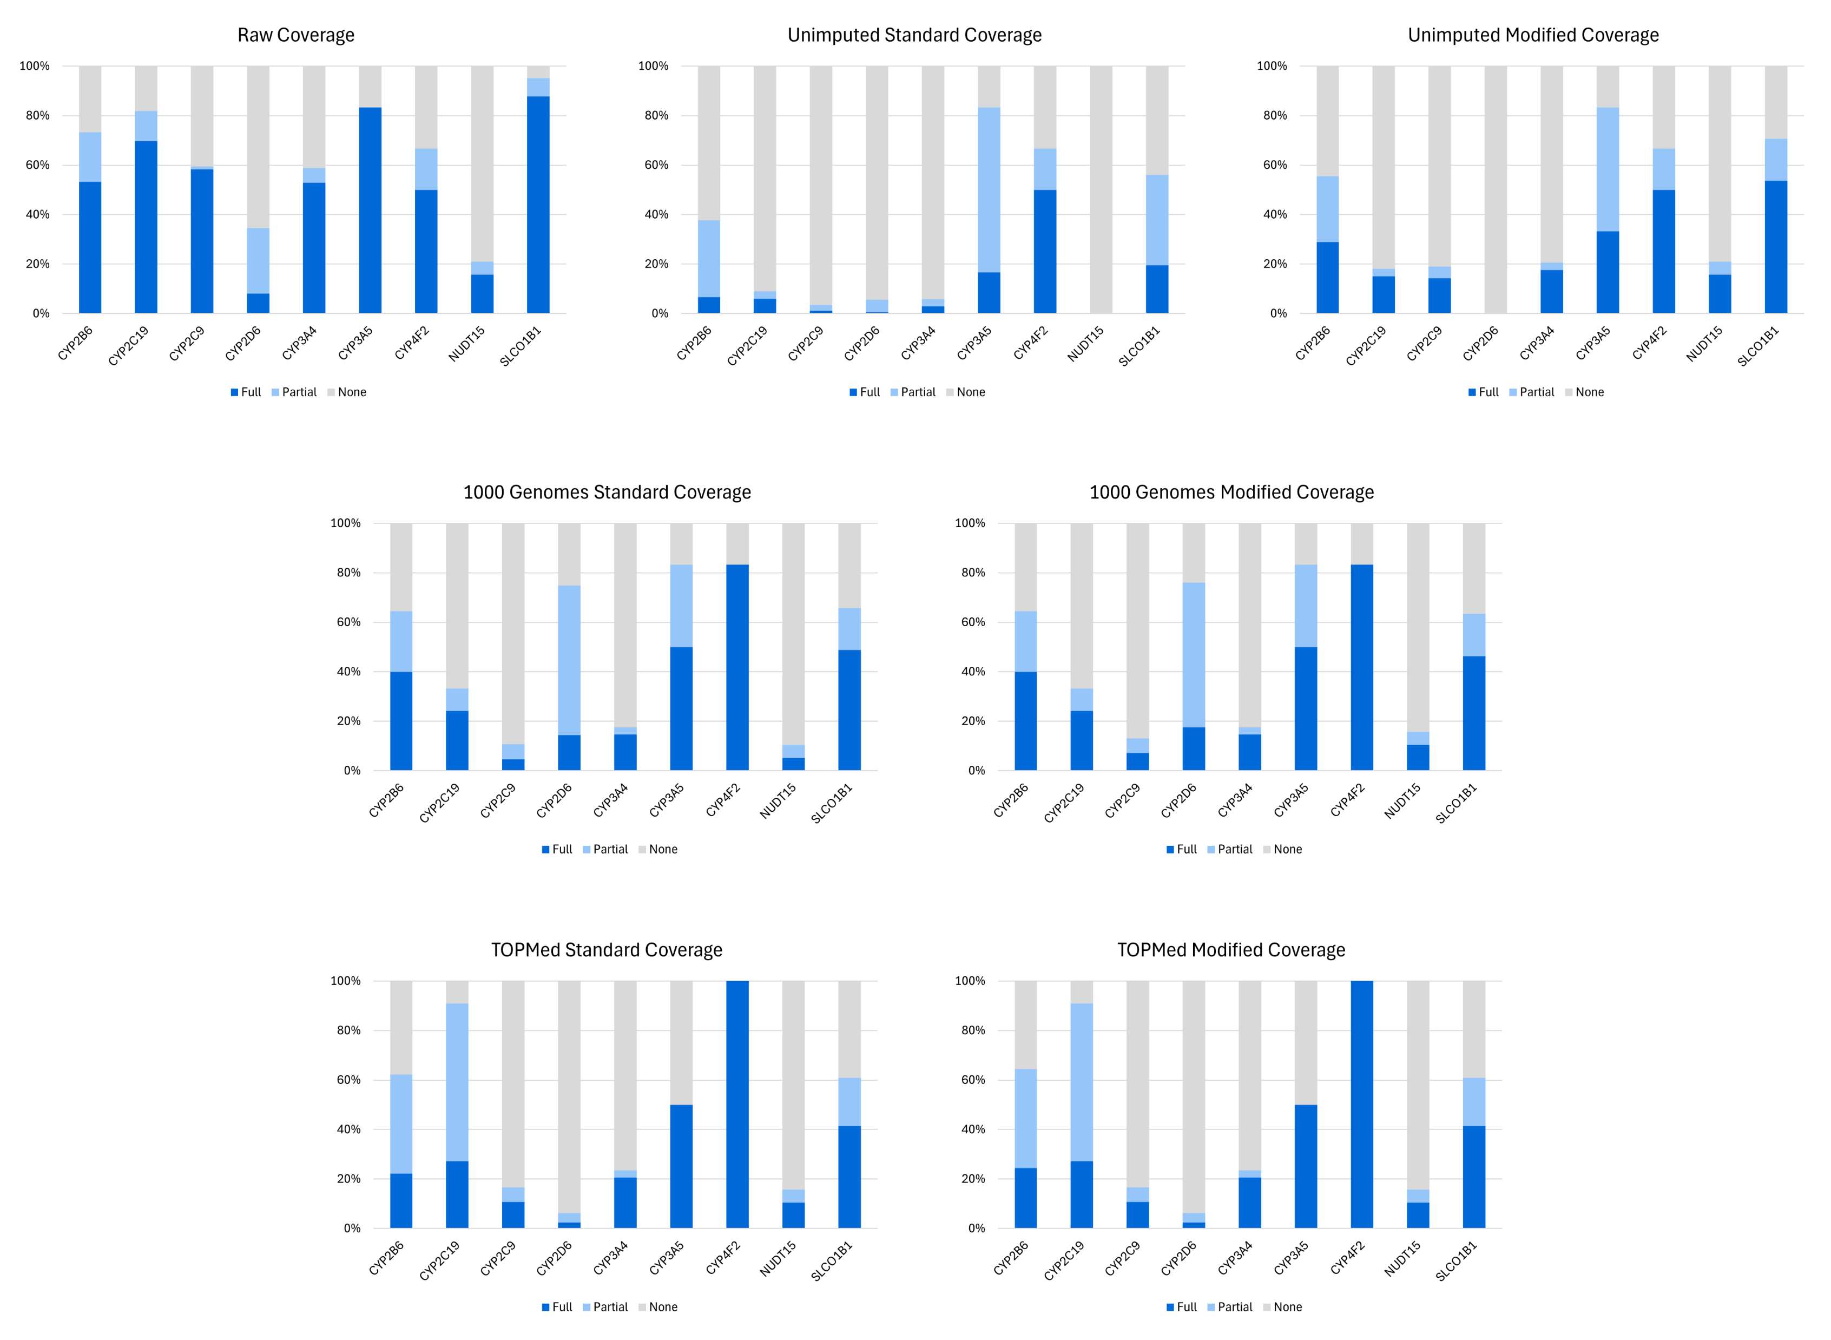
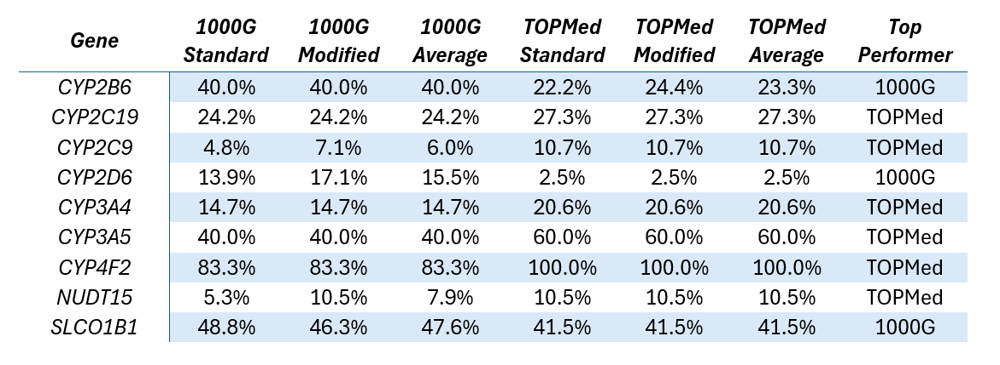
Notes:
As for overall gene coverage, both imputation methods show similar performance in most genes except for CYP2D6, in which 1000G offers 15.5% full coverage whereas topmed only offers 2.5% full coverage.

Slide 20
Impact of QC Filters
Less strict filtering methods resulted in the retention of more PGx variants
However, there were minimal differences between standard and modified filtering outcomes post-imputation
Notes:
Although the modified filtering method resulted in the retention of more PGx variants, there were minimal differences between the standard and modified filtering outcomes post-imputation
Therefore, when using imputation, the QC method has a less significant impact on PGx variant calling overall

Slide 21
Impact of Reference Panels
Both 1000G and TOPMed had comparable overall gene coverage, excluding CYP2D6
The discrepancies in CYP2D6 coverage can be partially attributed to differences in allele definitions between
GRCh37 and GRCh38
Accounting for these differences, 1000G still exhibits superior coverage
Notes:
Both 1000G and Topmed had comparable overall gene coverage, excluding CYP2D6
The discrepancies in CYP2D6 coverage can be partially attributed to differences the star allele definitions between reference builds
However, when accounting for these differences, 1000G still exhibits superior coverage for several CYP2D6 star alleles

Slide 22
Limitations of Reference Panels
TOPMed excelled at imputing rare PGx variants (MAF < 0.05) but struggled to impute more common ones (MAF > 0.1)
Both panels failed to impute nearly all tier 1 and tier 2 indels
Notes:
We found that Topmed excelled at imputing rare variants, however, it struggled to impute more common ones
This was consistent with another study, which found that regardless of the imputation algorithm used, the allele calls were biased towards the reference panel when the frequency of risk alleles in the case group was lower than in the reference
Both panels also failed to impute nearly all tier 1 and tier 2 indels
These indels primarily exist in the CYP genes, which are known to have regions of “low imputability” due to high GC content and segmental duplications
Furthermore, another study identified specific MAF thresholds for which Topmed could accurately impute indels
Most of the Tier 1 and Tier 2 indels have a MAF below this threshold, which further explains why Topmed was unable to impute them

Slide 23
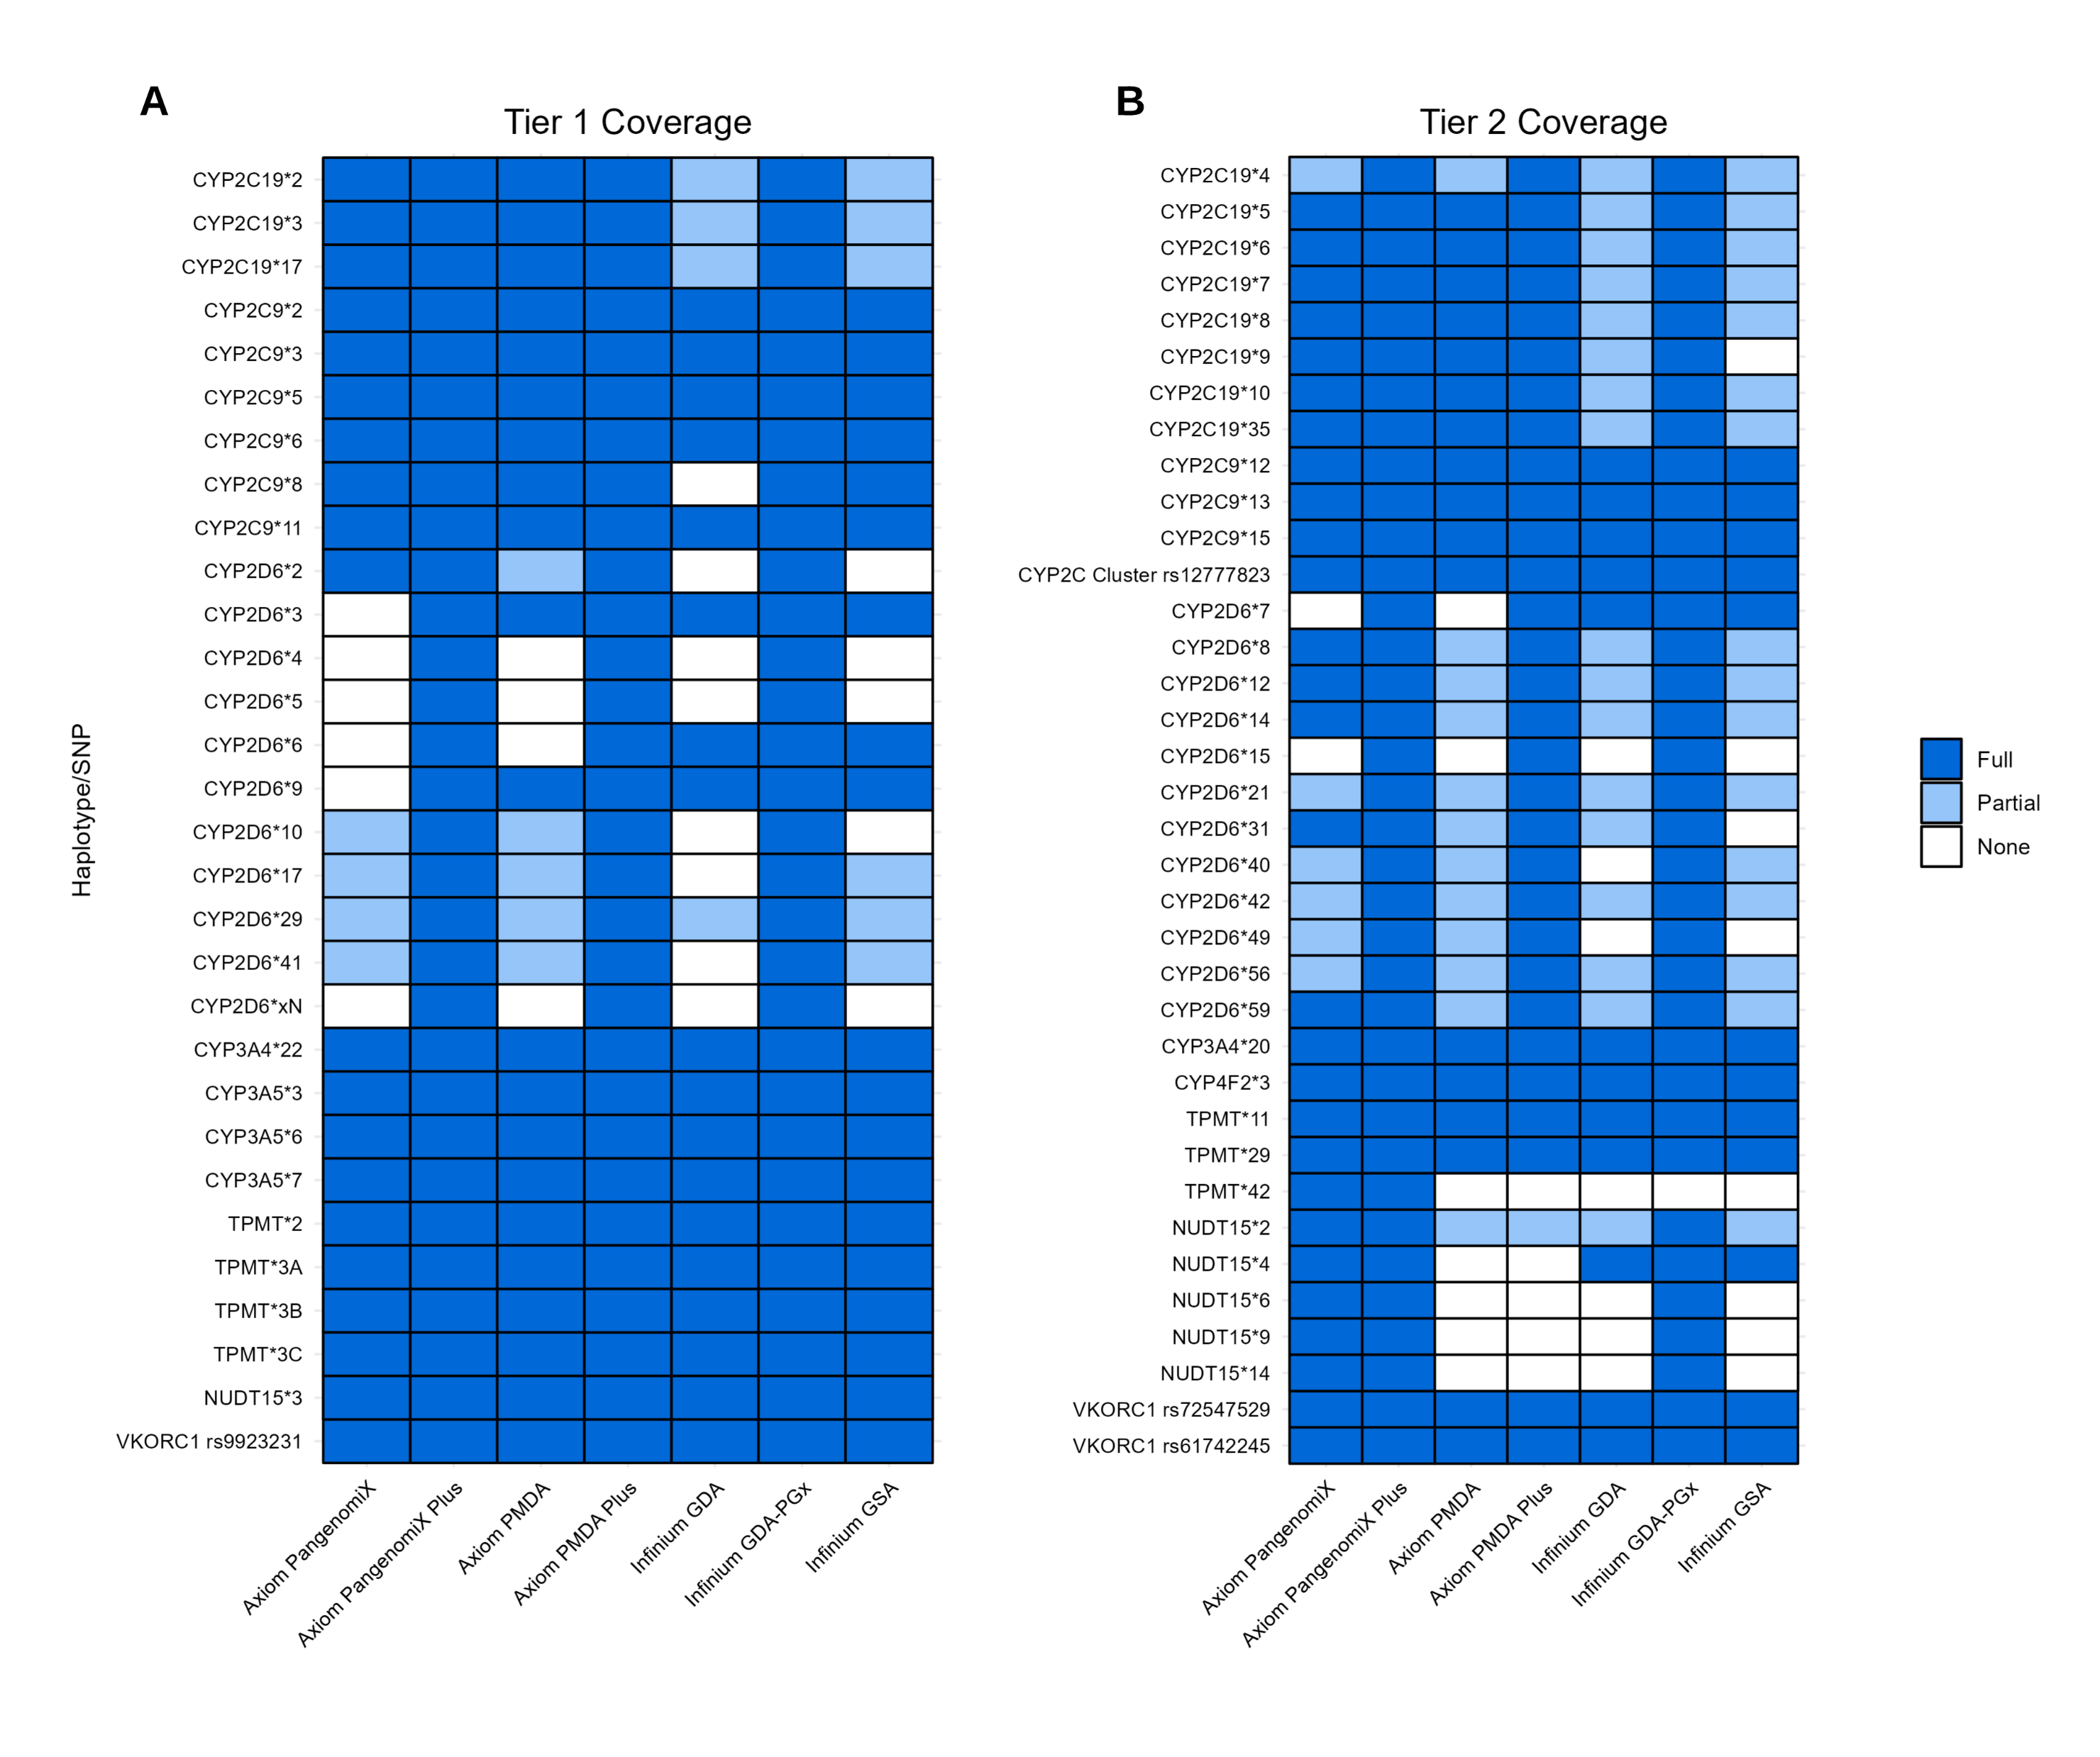
Limitations of Study
Lack of Diversity
GWAS dataset was primarily comprised of individuals with European ancestry
Genotyping Panel Constraint
The Infinium GSA lacks coverage for several key PGx variants
Image Source: Lenz C, Narang A, Bousman CA. Pharmacogenomic allele coverage of genome-wide genotyping arrays: a comparative analysis. Pharmacogenet Genomics. 2024 Feb 8;
Notes:
For the study itself, one of the primary limitations is the lack of diversity in the GWAS dataset.
Additionally, in my previous research, we identified that certain genotyping arrays like the Infinium GSA, lack coverage for several key PGx variants
The inability to directly genotype these variants could compromise imputation accuracy, as the algorithm may detect incorrect patterns of inheritance

Slide 24
Conclusions
This study suggests that the 1000G imputation panel is more suitable for processing GWAS data for PGx applications
However, imputation can be risky
Certain genotyping arrays may not be suitable for PGx applications, regardless of the QC or imputation methods used
Notes:
In conclusion, while the method of QC filtering does not have a significant impact on PGx variant calling, the choice of imputation panel does
This study suggests that the 1000G imputation panel is more suitable for processing GWAS data for PGx applications when the study population is primarily of European descent
However, imputation can be risky, as allele calls are biased towards the reference panel
Therefore, it is important to be cautious when performing secondary GWAS analyses, as certain arrays may not be suitable for PGx applications regardless of the QC or imputation methods used

Slide 25
Thank You :)
Notes:
Thank you so much for listening, I look forward to your questions!

